Slide 1



NASA Surveyor Program: Surveyors 1, 3, 5, 6 and 7
Chad Cantin
Mentor: Dr. Shane Byrne
Lunar and Planetary Laboratory
The University of Arizona
April 20, 2024

Slide 2
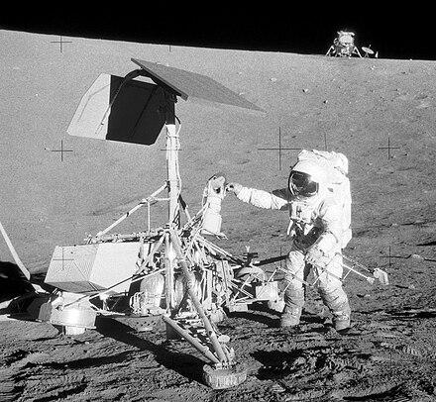
Background
NASA's Surveyor Program landed five spacecraft on the Moon's surface, each equipped with vidicon imaging systems, ultimately capturing over 87,000 images of the lunar surface. These images were transferred to physical 70mm film rolls.
This project aims to digitize these images and archive them alongside their metadata. Image digitization is complete, though further efforts have been employed to quality-check and organize the metadata, as well as ensure image quality is consistent and optimal.
‘Image Metadata’ - Data providing information about one or more aspects of the image, listed beside the Surveyor photo
Astronaut Pete Conrad with Surveyor 3 during Apollo 12 lunar landing
Credit: NASA, 1969

Slide 3
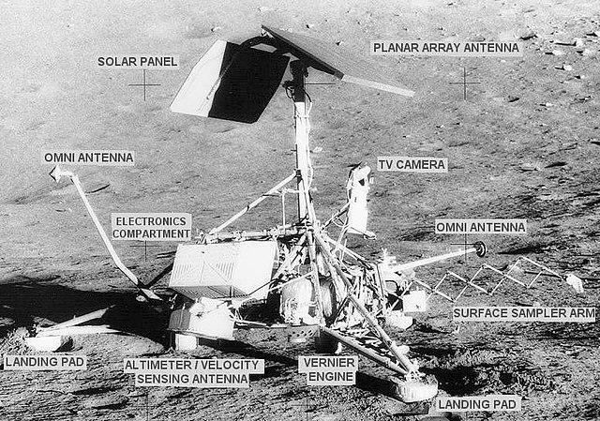
Objectives
Digitize image metadata in Microsoft Excel→Completed
Quality-check physical images
Correct inaccurate image metadata
Send finished spreadsheets to NASA for NASA's Planetary Data System to publicly publish
Instruments of Surveyor 3.
Credit: NASA, 1969

Slide 4
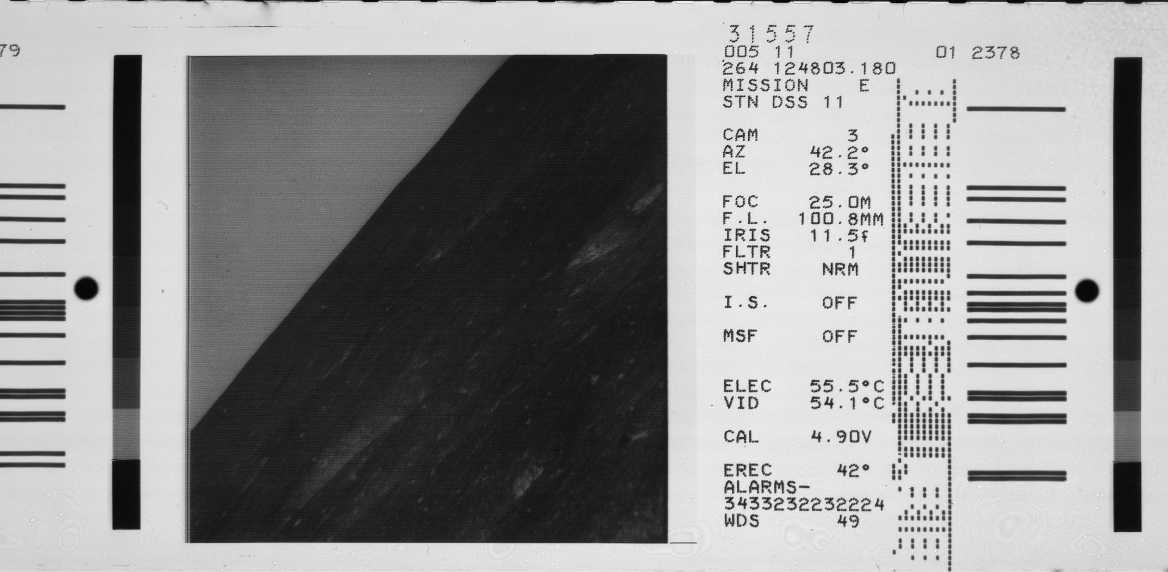
Sample Image with Metadata
Sample image of the lunar surface from surveyor 5 mission. Credit: NASA, 1967

Slide 5
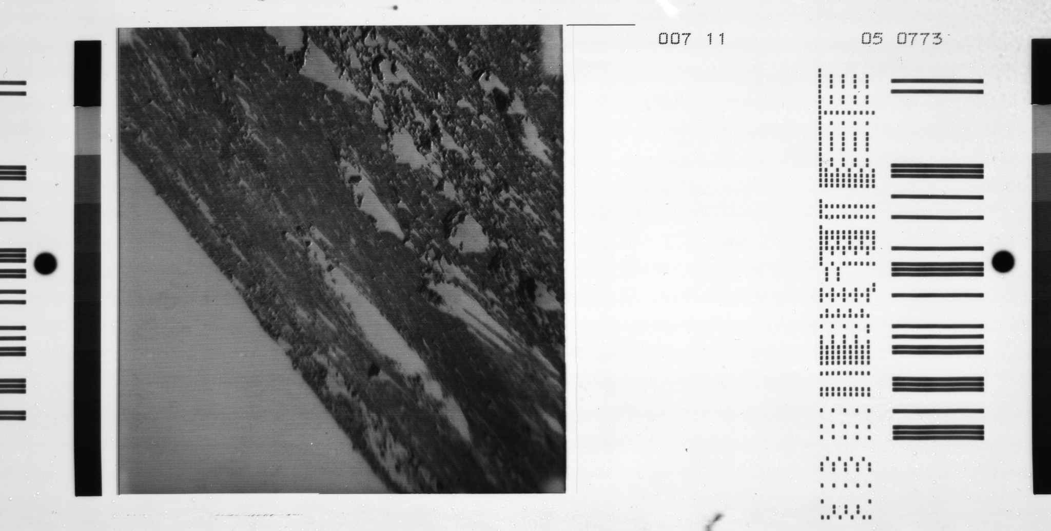
Methodology
Organize metadata within Microsoft Excel spreadsheets
Quality-check metadata against physical image
Utilize scripts to recognize apparent metadata inaccuracies
Correct inaccuracies throughout the digitized metadata
Example of possible inaccuracies throughout metadata.
Credit: NASA, 1969

Slide 6
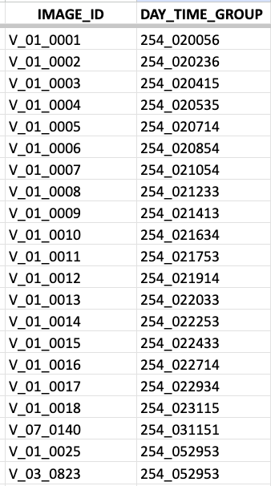
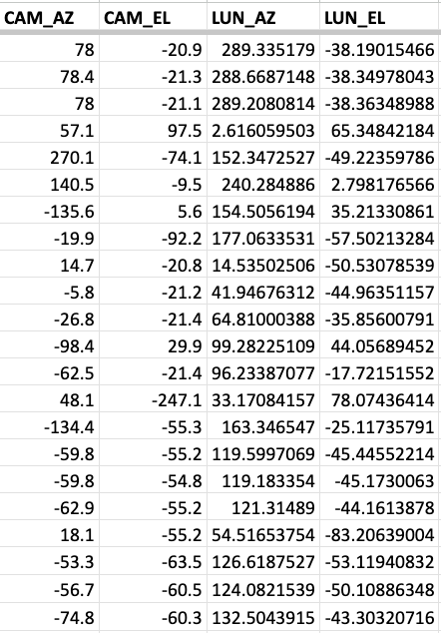
Sample Columns from Excel Spreadsheet
Listed:
Image ID
DTG
Cam. Azimuth
Cam. Elevation
Lunar Azimuth
Lunar Elevation
Unlisted:
Solar Azimuth
Solar Elevation
Resolution
Focus
Focal Length
Field of View
Filter Position
Shutter: On/Off
Calibration
Microsoft Excel spreadsheet for Surveyor 5 mission.
Credit: Shane Byrne, LPL

Slide 7
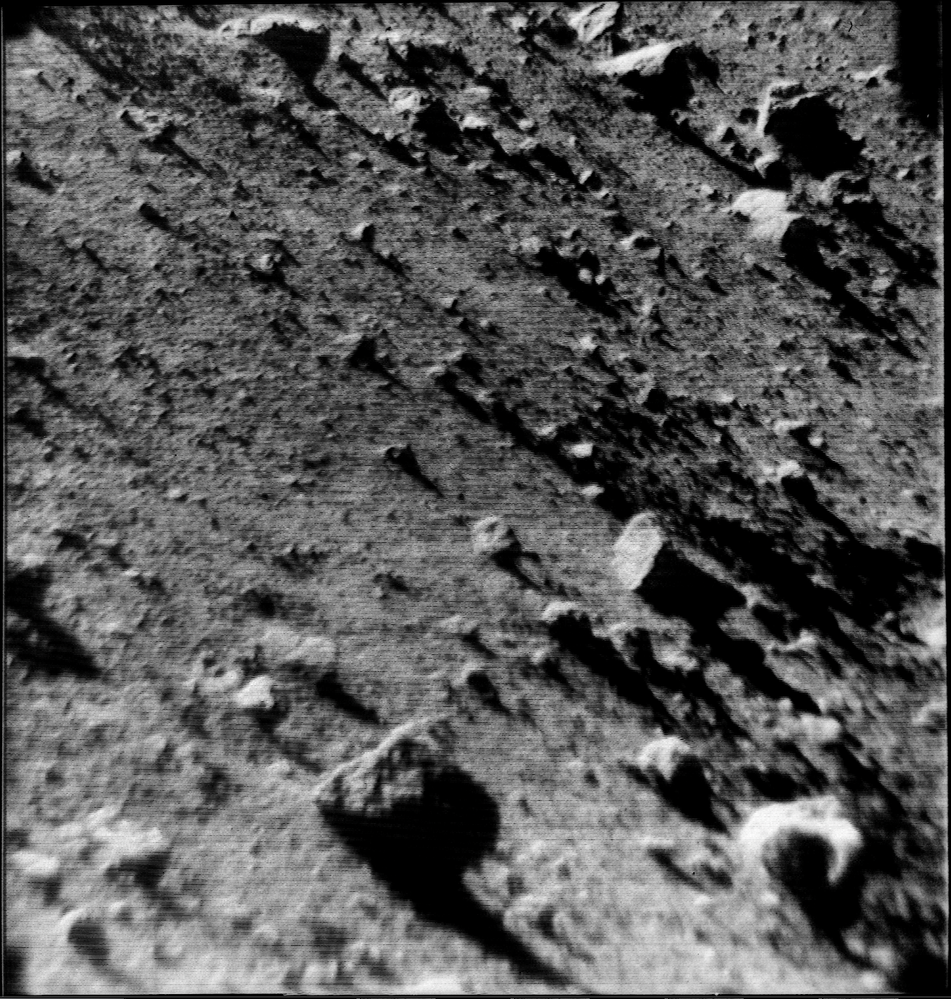
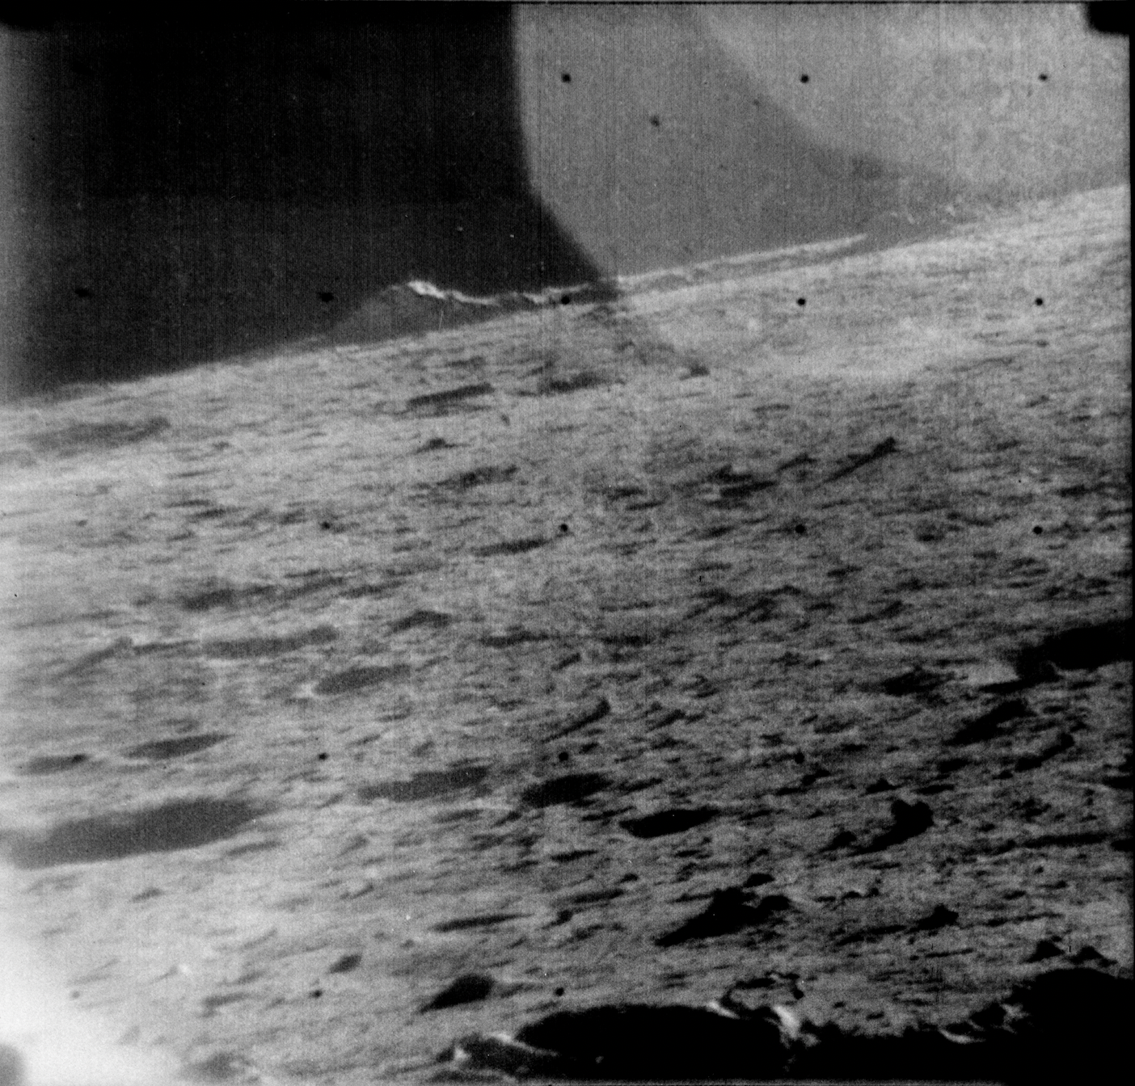
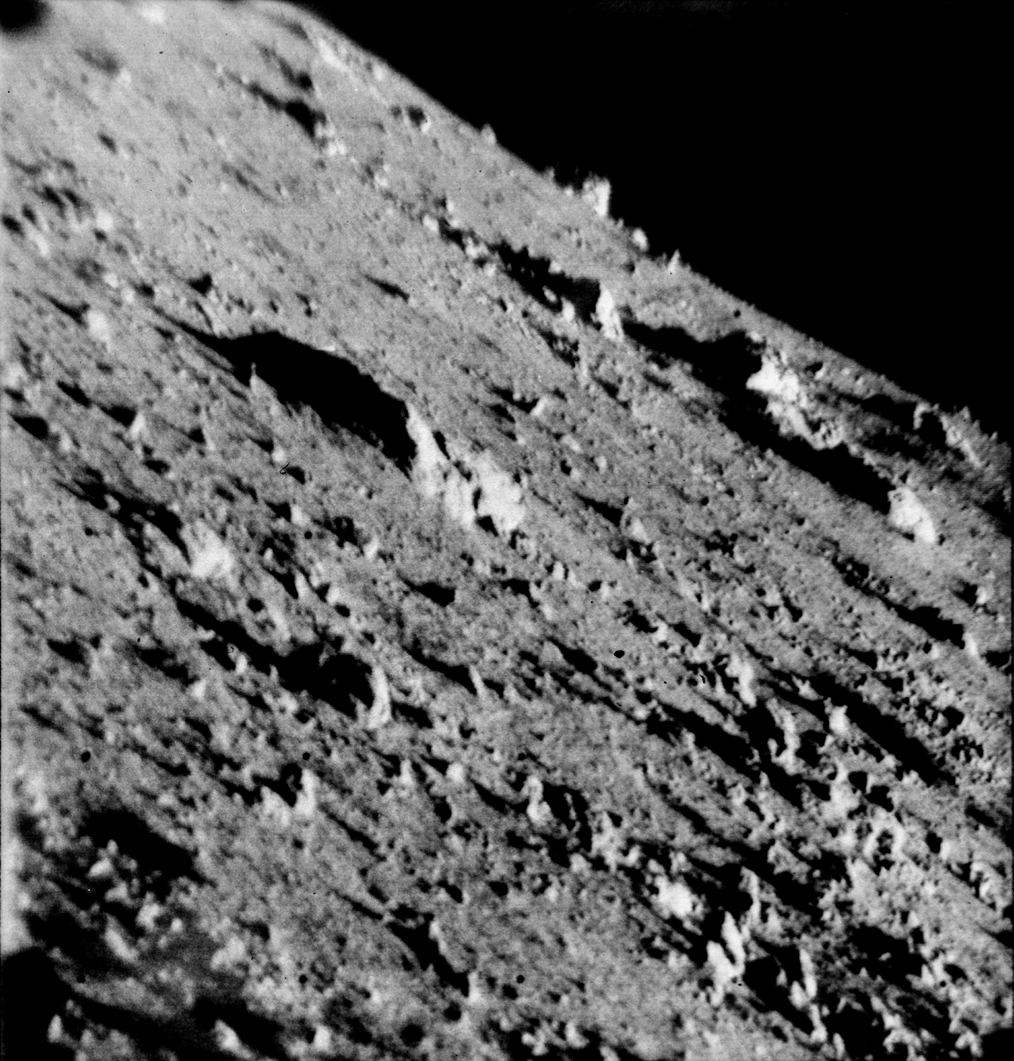
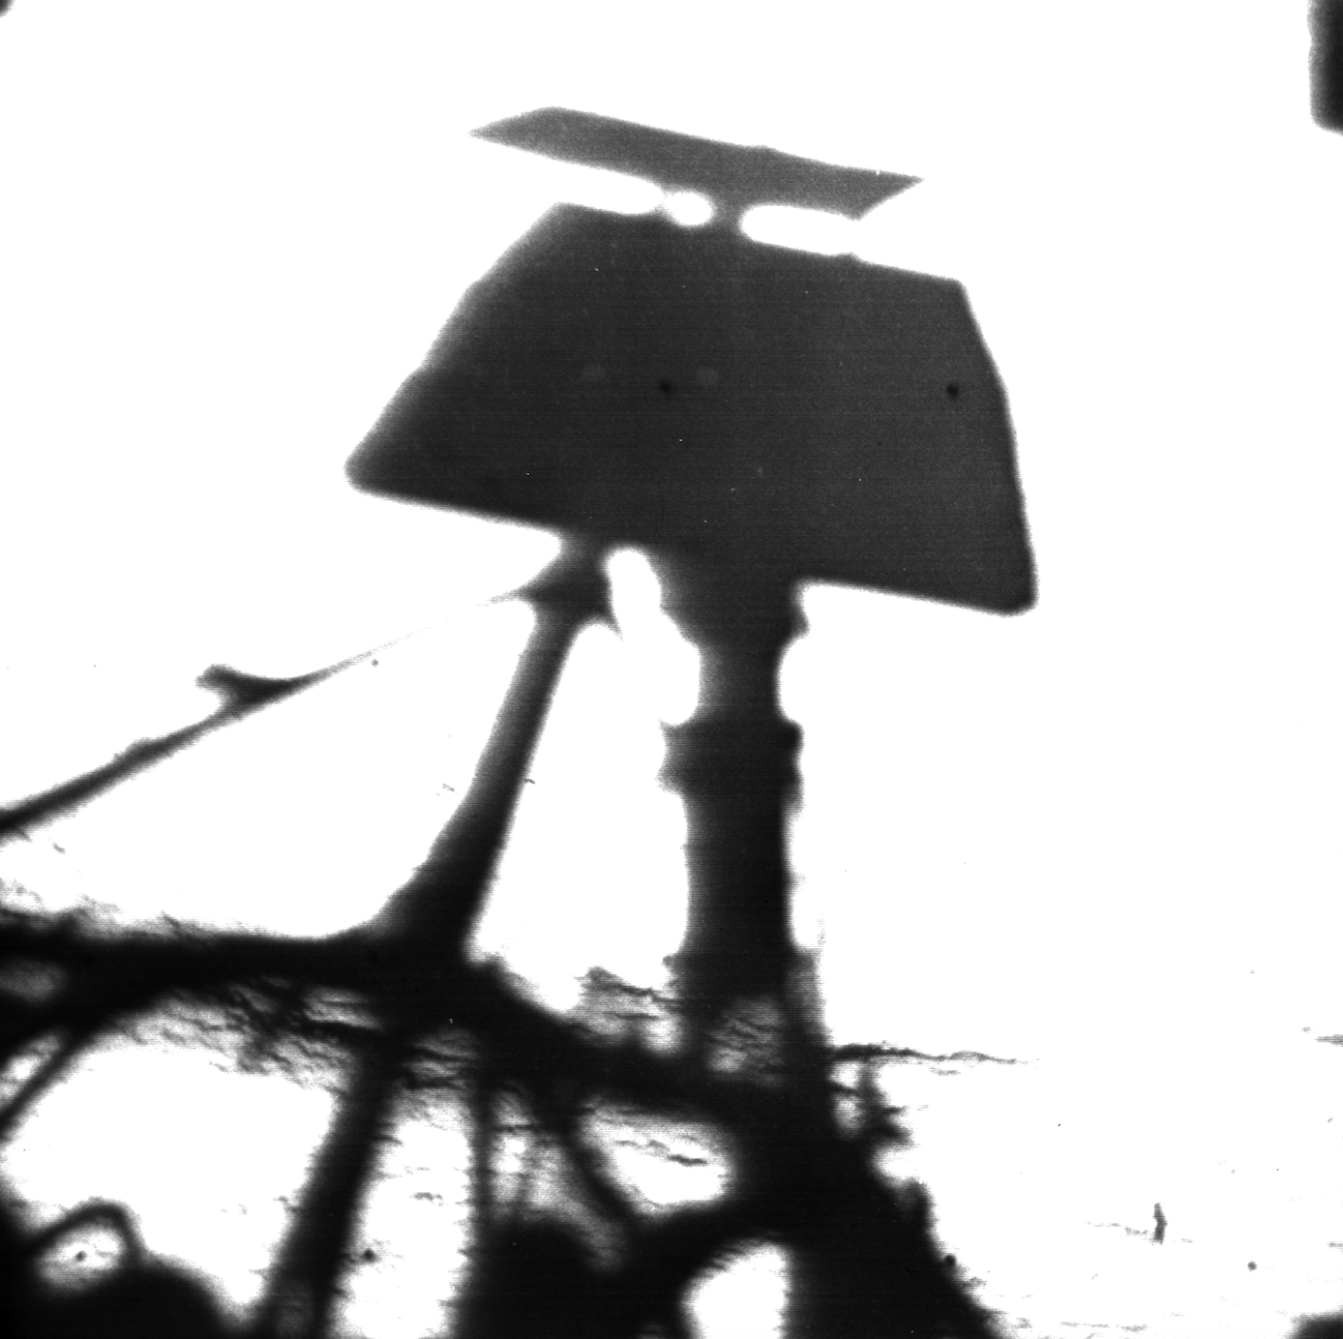
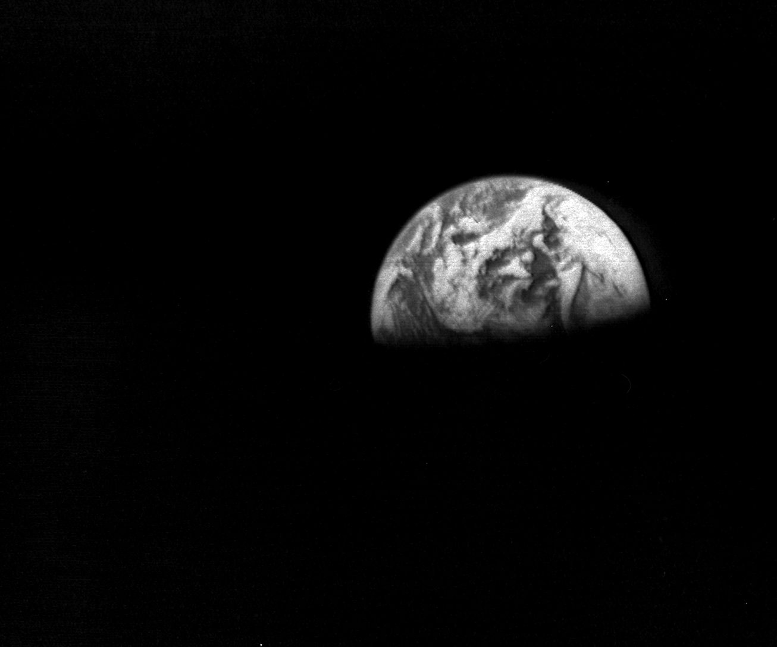
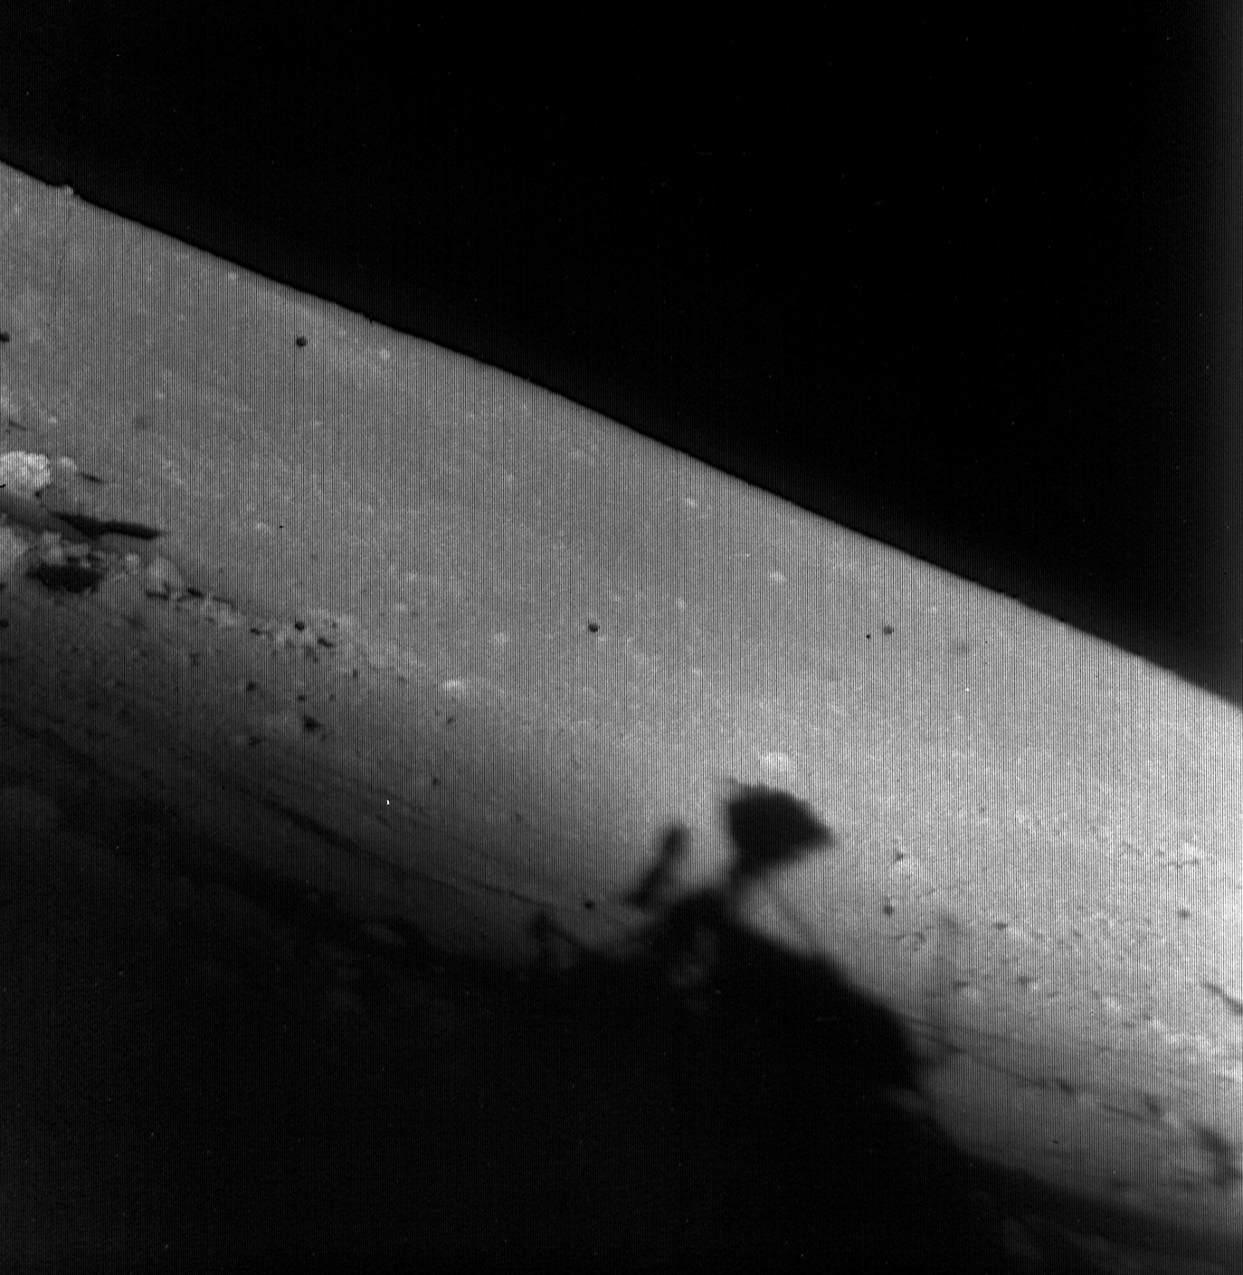
Sample Images
Images from Surveyors 5 and 7 Credit: NASA, 1967-1968

Slide 8
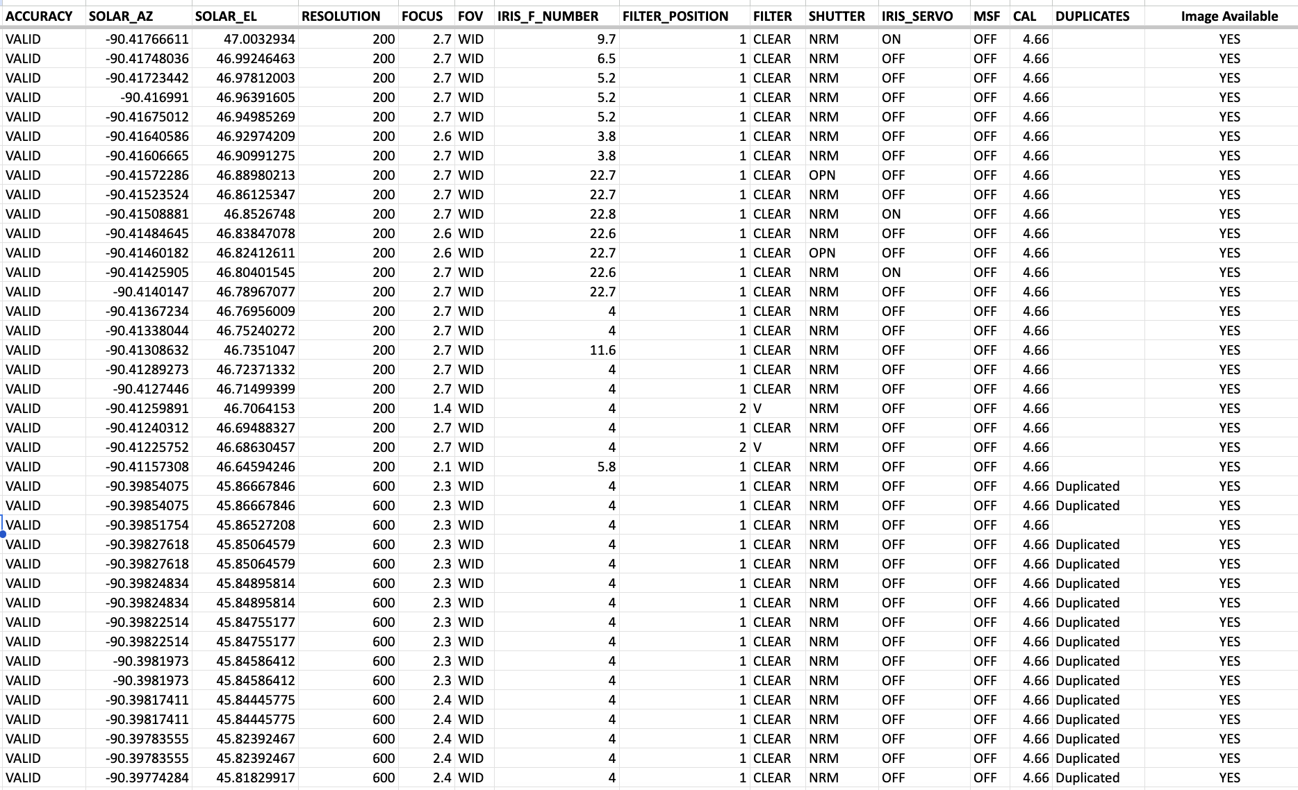
Results
Thousands of digitized image inaccuracies have been corrected
Spreadsheets for Surveyor 1, 3, and 5 are over ~75% completed
Surveyor 6 and 7 spreadsheets are over ~90% completed, with little-to-no errors to correct
Spreadsheet for Surveyor 6, each column completely filled out.
Credit: Byrne, Cantin (2024)

Slide 9
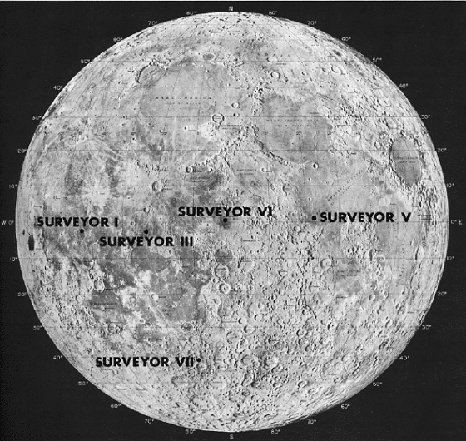
Interpretations of Results
Improved lunar surface data
Enhanced scientific lunar research
Geospatial mapping on lunar surface
Historical preservation
Public Accessibility
Location of each Surveyor landing.
Credit: NASA, LPI

Slide 10

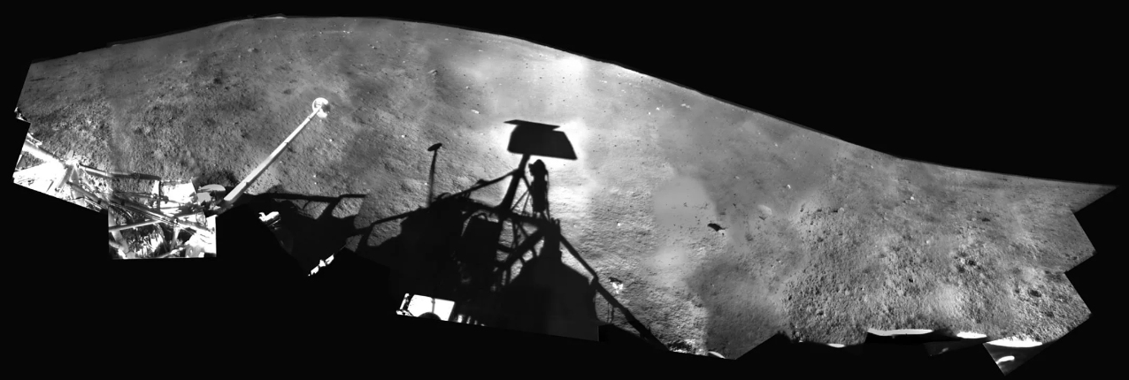
Conclusions
Final efforts will involve comparing physical image count to spreadsheet line count
Ensure every physical image is accounted for
Images may be combined into a larger panoramic image
Verified image metadata will support lunar research and exploration in the coming years
Surveyor 1 Panoramic Image.
Credit: Gary Rennilson / NASA / U of A / LPL / JPL

Slide 11
Acknowledgements
I would like to acknowledge my mentor, Shane Byrne, for accepting me into this project and guiding me over the past year. I would also like to acknowledge Justin Rennilson. Justin, now 97, worked on the Surveyor spacecraft with NASA in the 1960s and still puts forth his strongest efforts on this project, meeting with Dr. Byrne and I every other week.
Final acknowledgments to:
The Arizona/NASA Space Grant Consortium, The University of Arizona, and the University of Arizona’s Lunar and Planetary Laboratory.

Slide 12
Thank you!

